Slide 1
HEALTHCARE ANALYTICS
Medallion Lakehouse Platform
KPI
Bronze → Silver → Gold, governed by an automated data-quality gateway,
orchestrated end-to-end by Apache Airflow, delivered to Power BI.
Capstone Project — Data Engineering
Mo Amer

Slide 2
PROJECT OVERVIEW
What This Platform Does
1
2
3
4
Extract
Govern
Model
Deliver
Pulls five operational tables (patients, doctors, appointments, treatments, billing) live from a Neon PostgreSQL source via PySpark JDBC.
Every row passes an automated Data Quality Gateway — uniqueness, referential integrity, domain rules, financial sanity — before it's trusted.
Clean data is reshaped into a proper star schema: four dimensions, two facts, with revenue variance calculated and independently verified.
A 3-page executive Power BI report, refreshed automatically by Airflow the moment the pipeline finishes and reconciles.
Source: 5 Neon tables · Layers: Bronze / Silver / Gold + Quarantine · Orchestration: 6-task Airflow DAG · Output: 3-page Power BI report
Healthcare Analytics & Lakehouse Platform
2

Slide 3
ARCHITECTURE
Medallion Lakehouse Architecture
Neon
PostgreSQL
BRONZE
SILVER
GOLD
Power BI
→
→
→
→
source
raw · immutable · append-only
clean · deduplicated · validated
star schema
3-page report
QUARANTINE
rejected rows + reason logs
Every layer lives on MinIO (S3-compatible object storage) and is written with PySpark using the S3A connector. Gold is additionally exported as local Parquet for direct, reliable Power BI connectivity.
Healthcare Analytics & Lakehouse Platform
3

Slide 4
TOOLS & PLATFORMS
Technology Stack
Neon PostgreSQL
MinIO
PySpark
Parquet
Source database
S3-compatible object storage
Extraction, cleaning, transformation
Storage format across all layers
Apache Airflow
Docker Compose
Custom DQ Gateway
Power BI
End-to-end orchestration
Reproducible local deployment
Data quality & governance
3-page executive report
Healthcare Analytics & Lakehouse Platform
4

Slide 5
GOVERNANCE
The Data Quality Gateway
Uniqueness
Primary keys must be non-null and unique; re-ingested duplicates resolved by latest ingestion time.
BRONZE (raw)
Date Sanity
appointment_date cannot be set in the future relative to execution date.
Positive Financials
billed_amount and treatment_cost must be strictly greater than zero.
DQ GATEWAY
Domain Enums
payment_status must be one of Paid, Pending, Failed, Refunded.
SILVER
QUARANTINE
Referential Integrity
Every foreign key must resolve to a real parent row in Silver.
Every rejection is logged with a full reason and timestamp — nothing is silently dropped.
Healthcare Analytics & Lakehouse Platform
5

Slide 6
DIMENSIONAL MODEL
Gold Layer — Star Schema
dim_patients
dim_doctors
dim_treatments
dim_date
fact_appointments
fact_billing_treatments
appointment_id · patient_id · doctor_id · date_key
status · is_noshow · reason_for_visit
bill_id · patient_id · treatment_id · doctor_id
billed_amount · treatment_cost · revenue_variance
revenue_variance = billed_amount − treatment_cost
Healthcare Analytics & Lakehouse Platform
6

Slide 7
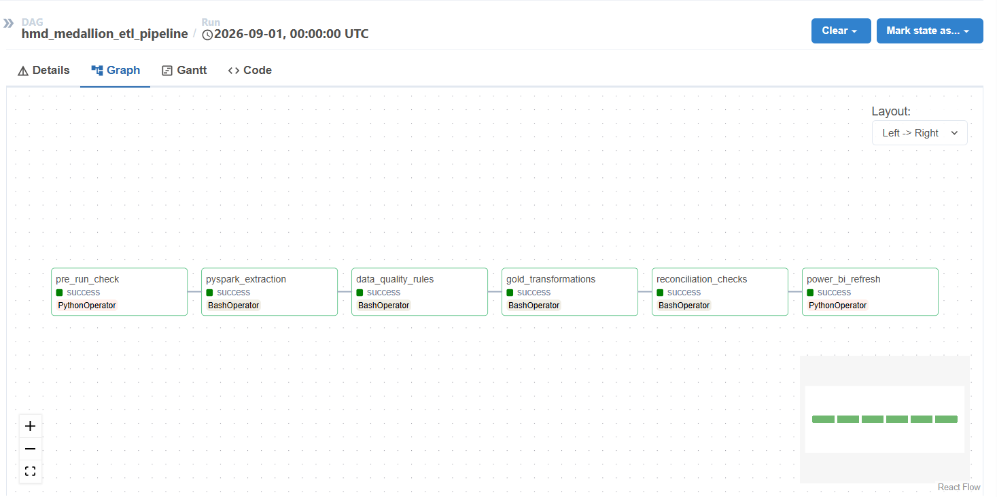
APACHE AIRFLOW
End-to-End Orchestration
1
pre_run_check — live Neon + MinIO health & bucket check
2
pyspark_extraction — Bronze ingestion
3
data_quality_rules — Silver DQ Gateway
4
gold_transformations — star schema build
5
reconciliation_checks — fails the run on any mismatch
6
power_bi_refresh — triggers the Service dataset refresh
All 6 tasks succeeding end-to-end, including the Power BI refresh trigger
Healthcare Analytics & Lakehouse Platform
7

Slide 8
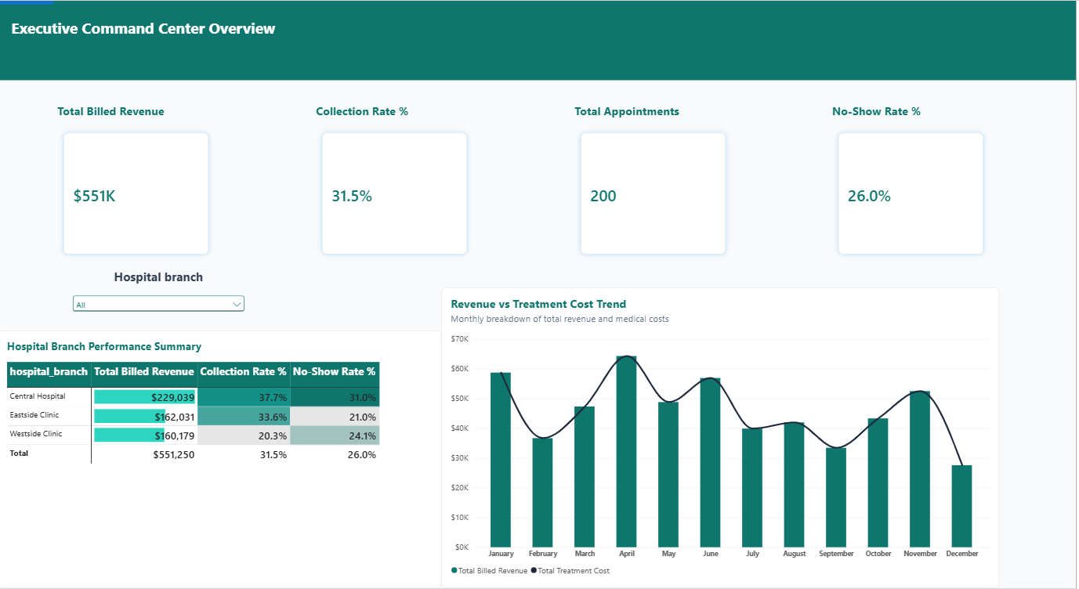
POWER BI — PAGE 1
Executive Command Center Overview
Healthcare Analytics & Lakehouse Platform
8

Slide 9
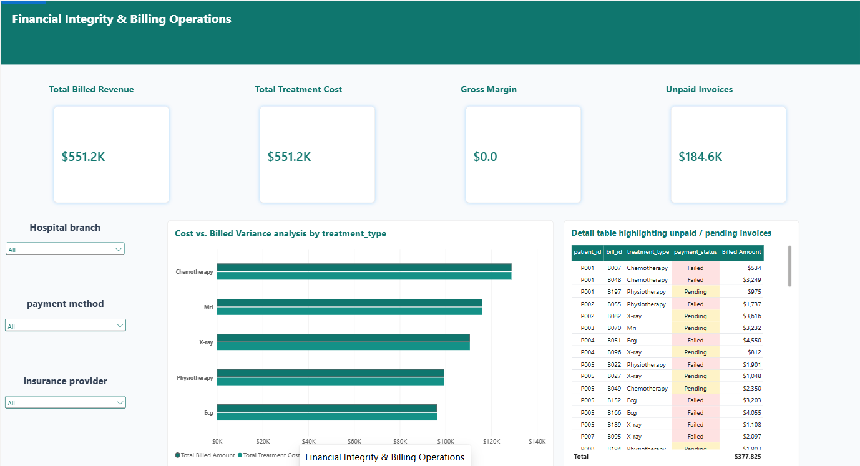
POWER BI — PAGE 2
Financial Integrity & Billing Operations
Healthcare Analytics & Lakehouse Platform
9

Slide 10
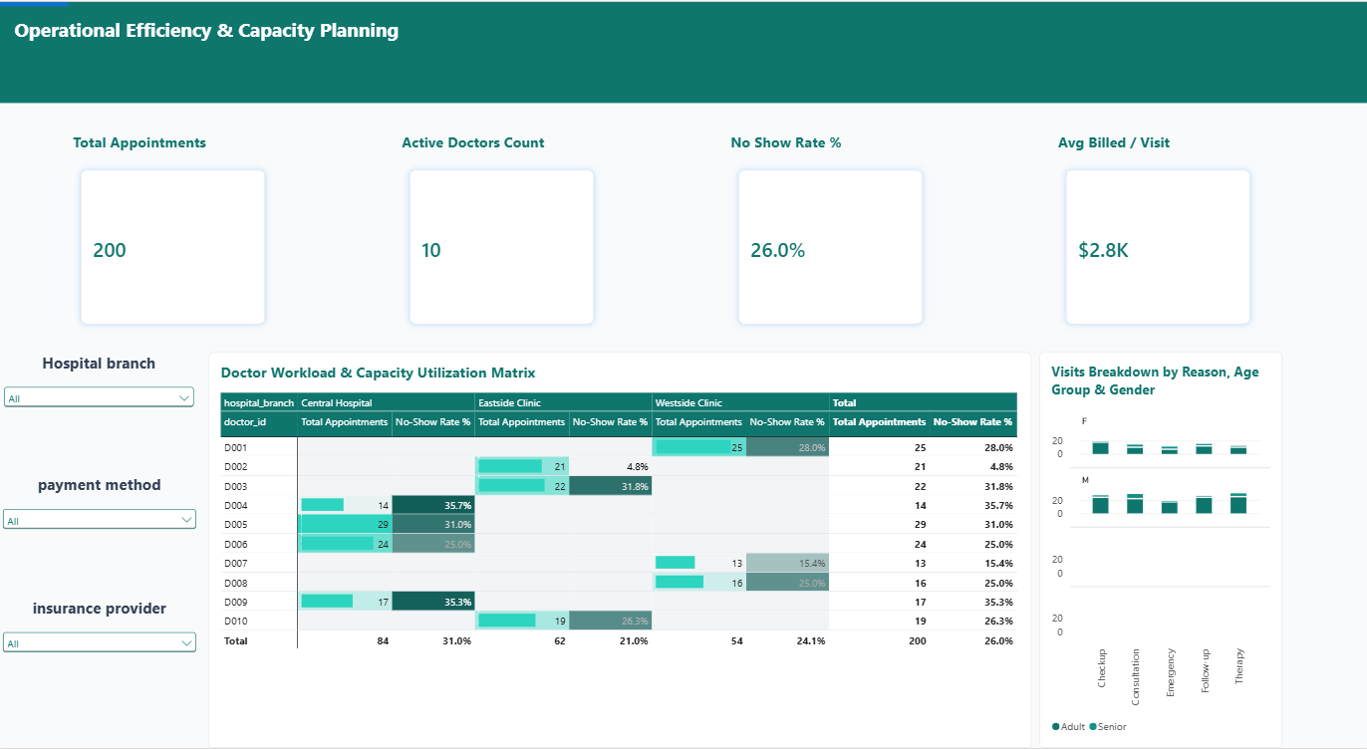
POWER BI — PAGE 3
Operational Efficiency & Capacity Planning
Healthcare Analytics & Lakehouse Platform
10

Slide 11
RECONCILIATION & INTEGRITY
Zero Silent Data Loss
✓
✓
✓
Bronze → Silver
Silver → Gold
Formula Sanity
Raw Bronze row count and financial sum must exactly equal Silver + Quarantine.
Row counts and financial sums must match exactly — this join is lossless by construction.
SUM(revenue_variance) is independently recomputed as SUM(billed_amount) − SUM(treatment_cost) and compared.
Any mismatch fails the Airflow task immediately — a broken pipeline never silently reports success, and Power BI never refreshes on unreconciled data.
Healthcare Analytics & Lakehouse Platform
11

Slide 12
BUILT ON A FOUNDATION OF
Governed Data, Verified Twice
Automated data-quality gating, end-to-end reconciliation, and a fully orchestrated Airflow pipeline — from a live operational database to an executive-ready Power BI report.
Thank you.
Mo Amer — Healthcare Analytics & Lakehouse Platform Capstone

